Slide 1
Operating Systems
Lecture 6-7 – CPU Scheduling Policies

Slide 2
Short term Scheduling policies
Also referred as CPU Scheduling
Determine which process should be brought into running state and when to take that decision.

Slide 3
Short Term Scheduling Categories
Based on Decision Mode
Specifies the instants in time at which the selection function is exercised.
Two categories:
Nonpreemptive
Preemptive

Slide 4
Non-pre-emptive vs Pre-emptive
Non-preemptive
Once a process is in the running state, it will continue until it terminates or blocks itself for I/O
Preemptive
Currently running process may be interrupted and moved to ready state by the OS
Preemption may occur when new process arrives, on an interrupt, or periodically.
Notes:
Non-preemptive
In this case, once a process is in the Running state, it continues to execute until
it terminates or
it blocks itself to wait for I/O or to request some operating system service.
Preemptive:
The currently running process may be interrupted and moved to the Ready state by the operating system.
The decision to preempt may be performed
when a new process arrives;
when an interrupt occurs that places a blocked process in the Ready state;
or periodically, based on a clock interrupt.

Slide 5
Selection Function
Every Scheduling policy has a selection function
Selection function determines which process, among ready processes, is selected next for execution.
May be based on priority, resource requirements, or the execution characteristics of the process.

Slide 6
Important Time Instances/Calculations
Arrival Time (AT): Instance of time at which the process arrives at the ready queue
Service Time/Burst Time (BT): Time required by a process for execution at the processor
Completion Time (CT): Instance of time at which the process completes its execution
Turnaround Time (TAT): Total time from arrival of a process to its completion
Turnaround Time = Completion Time – Arrival Time
Waiting Time (w): Amount of time a process waits for processor
Waiting Time = Turnaround time – Service Time

Slide 7
First-Come-First-Served
Each process joins the Ready queue
When the current process ceases to execute, the process that has waited the longest in the Ready queue is selected for execution next
Decision Mode: Non-preemptive
Selection Function: Max[Waiting Time] or Min[Arrival Time]
Notes:
The simplest scheduling policy is first-come-first-served (FCFS),
aka. first-in-first-out (FIFO) or a strict queuing scheme.
As each process becomes ready, it joins the ready queue.
When the currently running process ceases to execute, the process that has been in the ready queue the longest is selected for running.

Slide 8
Pros and Cons
Advantages
Easy to implement with simple FIFO Queues
Fair; Each Process at some point in time would get the processor
Disadvantages
A short process may have to wait a very long time before it can execute
Inefficient use of Processor and I/O Devices

Slide 9
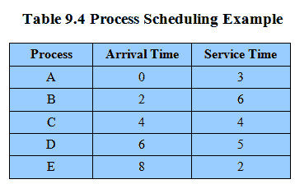
Process Scheduling Example
Example set of processes, consider each a batch job
Table

Slide 10
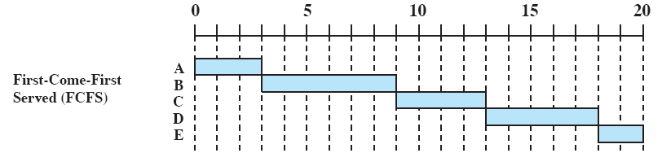
Gantt Chart
A Gantt chart is a visual view of tasks scheduled over time. It can be used to visualize the execution schedule of processes based on different scheduling policies. Following Gantt chart illustrates the execution of processes shown in previous slide (Table) with first come first served policy.

Slide 11
Calculating Turnaround Time & Waiting Time
For Calculations refer Slide 5
Process | Arrival Time | Service Time | Completion Time | Turnaround Time | Waiting Time
A | 0 | 3 | 3 | 3 | 0
B | 2 | 6 | 9 | 7 | 1
C | 4 | 4 | 13 | 9 | 5
D | 6 | 5 | 18 | 12 | 7
E | 8 | 2 | 20 | 12 | 10
 |  |  |  | Avg. TAT: 8.6 units | Avg. WT: 4.6 Units

Slide 12
Shortest Job First
Process which have the shortest burst time/Service time are scheduled first.
The selection however depends on the arrival time as well since the policy is non-preemptive
If the arrival time for processes are different, which means all the processes are not available in the ready queue at time 0, and some jobs arrive after some time, in such situation, sometimes process with short burst time have to wait for the current process's execution to finish, because in Non Pre-emptive SJF, on arrival of a process with short duration, the existing job/process's execution is not halted/stopped to execute the short job first.
Decision Mode: Non-Preemptive
Selection Function: Min[Burst Time]

Slide 13
Pros and Cons
Advantages
This is the best approach to minimize waiting time and response time
Disadvantages
Not practical : difficult to predict burst time
Learning to predict future
May starve long jobs
This scheduling algorithm is optimal if all the jobs/processes are available at the same time. (either Arrival time is 0 for all, or Arrival time is same for all)

Slide 14
Problem Example
Process | Arrival Time | Service Time
P1 | 0 | 8
P2 | 1 | 4
P3 | 2 | 9
P4 | 3 | 5

Slide 15
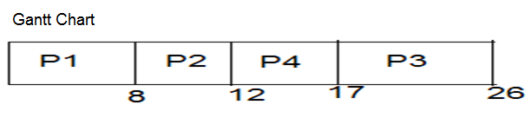
Solution with SJF
Process | Arrival Time | Service Time | Completion Time | Turnaround Time | Waiting Time
P1 | 0 | 8 | 8 | 8 | 0
P2 | 1 | 4 | 12 | 11 | 8
P3 | 2 | 9 | 26 | 24 | 15
P4 | 3 | 5 | 17 | 14 | 9
 |  |  |  | Avg. TAT=14.25 | Avg. WT=8

Slide 16
Shortest Remaining Time
Also known as Shortest Job First with Pre-emption
Decision Mode: Pre-emptive
Selection Function: min[s-e]
If a new process arrives with a shorter burst time than remaining of current process then schedule new process
Advantage
Further reduces average waiting time and average response time
Disadvantage
Not practical (Predicting burst time)

Slide 17
Problem Example
Process | Arrival Time | Service Time
P1 | 0 | 8
P2 | 1 | 4
P3 | 2 | 9
P4 | 3 | 5

Slide 18

Solution with SRTF
Process | Arrival Time | Service Time | Completion Time | Turnaround Time | Waiting Time
P1 | 0 | 8 | 17 | 17 | 9
P2 | 1 | 4 | 5 | 4 | 0
P3 | 2 | 9 | 26 | 24 | 15
P4 | 3 | 5 | 10 | 7 | 2
 |  |  |  | Avg. TAT=13 | Avg. WT=6.5

Slide 19
Round Robin
Decision Mode: Pre-emptive; Selection Function: Constant
Uses preemption based on a clock
also known as time slicing, because each process is given a slice of time before being preempted.
Notes:
A straightforward way to reduce the penalty that short jobs suffer with FCFS is to use preemption based on a clock.
The simplest such policy is round robin.
Also known as time slicing, because each process is given a slice of time before being preempted.

Slide 20
Round Robin
Clock interrupt is generated at periodic intervals
When an interrupt occurs, the currently running process is placed in the ready queue
Next ready job is selected
Notes:
A clock interrupt is generated at periodic intervals.
When the interrupt occurs, the currently running process is placed in the ready queue, and the next ready job is selected on a FCFS basis.

Slide 21
Pros and Cons
Advantages
Fair (Each process gets a fair chance to run on the CPU)
Faster response time
Disadvantages
Increased process and mode switching
Turnaround time typically larger than SRTF

Slide 22
Major Design Issue
Selecting the value of time quantum (q)
Performance depends on quantum q
Small q: Overhead due to Process switches (& scheduling) q should be large wrt process-switching time
Large q: Behaves like FCFS rule of thumb: 80% of bursts should be shorter than q (also improves turnaround time)

Slide 23
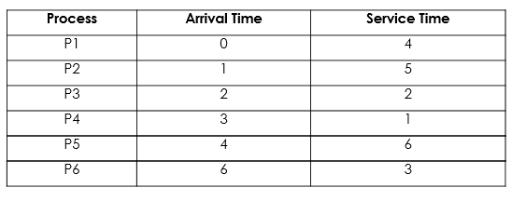
Problem Example

Slide 24

Solution with Round Robin
Ready Queue: P1, P2, P3, P1, P4, P5, P2, P6, P5, P2, P6, P5
Gantt Chart

Slide 25
Solution Contd.
Process | Arrival Time | Service Time | Completion Time | Turnaround Time | Waiting Time
P1 | 0 | 4 | 8 | 8 | 4
P2 | 1 | 5 | 18 | 17 | 12
P3 | 2 | 2 | 6 | 4 | 2
P4 | 3 | 1 | 9 | 6 | 5
P5 | 4 | 6 | 21 | 17 | 11
P6 | 6 | 3 | 19 | 13 | 10
 |  |  |  | Avg. TAT=10.8 | Avg. WT=7.3

Slide 26
Multi-Level Feedback Scheduling
Penalize jobs that have been running longer
If we have no indication of the relative length of various processes, then none of SPN, SRT, and HRRN can be used.
Another way of establishing a preference for shorter jobs is to penalize jobs that have been running longer.
if we cannot focus on the time remaining to execute, let’s focus on the time spent in execution so far
Scheduling is done on a preemptive (at time quantum) basis, and a dynamic priority mechanism is used.
When a process first enters the system, it is placed in RQ0
After its first preemption, when it returns to the Ready state, it is placed in RQ1.
Each subsequent time that it is preempted, it is demoted to the next lower-priority queue.
A short process will complete quickly, without migrating very far down the hierarchy of ready queues.
A longer process will gradually drift downward.
Thus, newer, shorter processes are favoured over older, longer processes.
Once in the lowest-priority queue, a process cannot go lower, but is returned to this queue repeatedly until it completes execution.
Thus, this queue is treated in round-robin fashion.

Slide 27
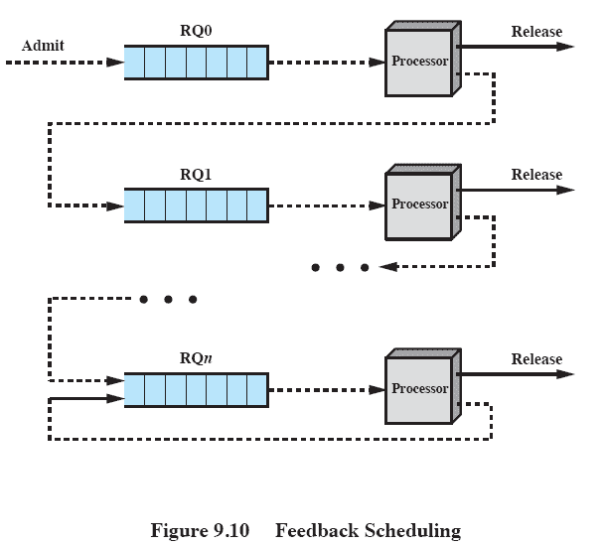
Multi-level Feedback Scheduling

Slide 28
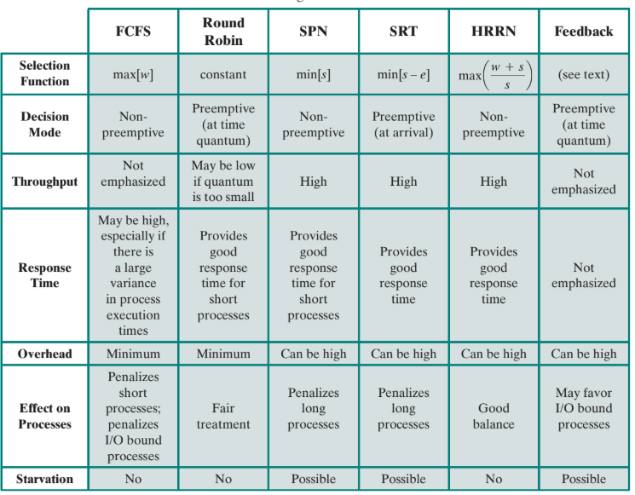
Comparison of scheduling algorithms

Slide 29
Thank You!

